Slide 1


Wireless Intrusion Detection Mechanism Using Artificial Neural Network
Kolawole Ikeoluwa J. 140407007
Aderibigbe Toyese I. 140407025
Supervised by: Dr. K.O. Orolu

Slide 2

Introduction
Cyber security are techniques of protecting computers, networks, programs and data from unauthorized access or attacks that are aimed for exploitation (ecomomictimes, 2019)
AFig. 1 A depiction of cyber security on a laptop. (https: www.ecpi.edu 01-11-19)
Notes:
Image source:-
https://pixabay.com/en/technology-industry-big-data-cpu-3092486/

Slide 3
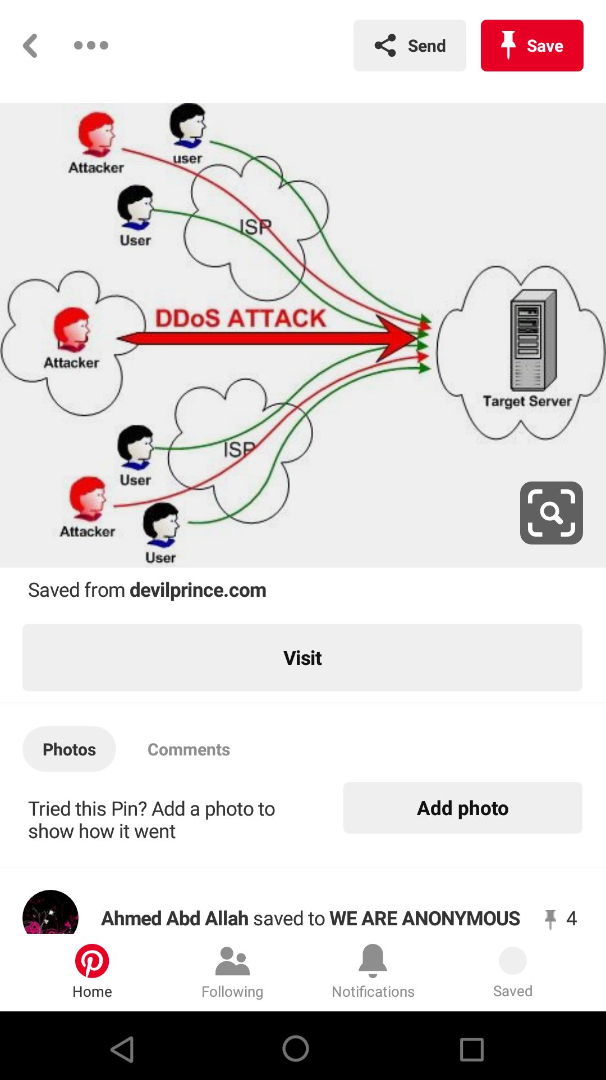
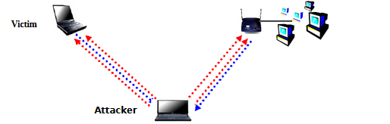
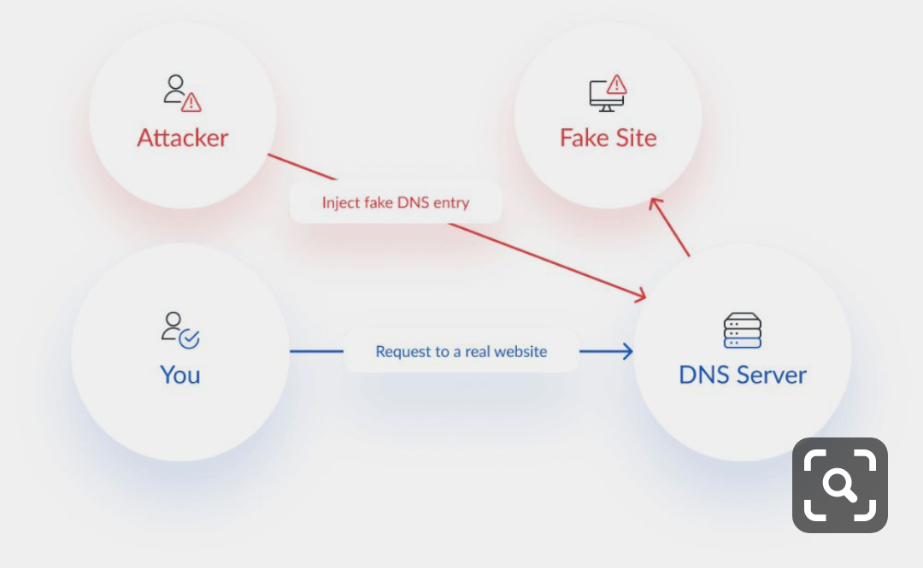
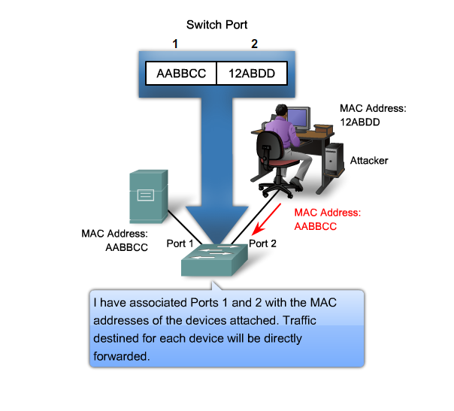
Denial of Service (DoS)
MAC Address Spoofing
Examples of Security Threats
DNS Spoofing
Man in the Middle Attack

Slide 4

STATEMENT OF PROBLEM
Protection of information and private data from unauthorized access.
Deployment of intrusion detection algorithm and methodology to improve cyber security.
Notes:
Image source:-
https://pixabay.com/en/architecture-building-business-2179108/

Slide 5

Project Goal
Design and simulate an authentication mechanism for wireless networks using artificial neural network (ANN).
Notes:
Image source:-
https://pixabay.com/en/computer-keyboard-apple-laptop-2563737/

Slide 6
Scope of Project
Out Scope
Other forms of wireless network intrusion detection mechanism such as Two Factor Authentication (2FA), Virtual Private Network (VPN) and so on will not be considered within this study
In Scope
This study will cover the bounds of wireless network intrusion detection using the MAC Address and will be limited to the neural network toolbox available on MATLAB.

Slide 7
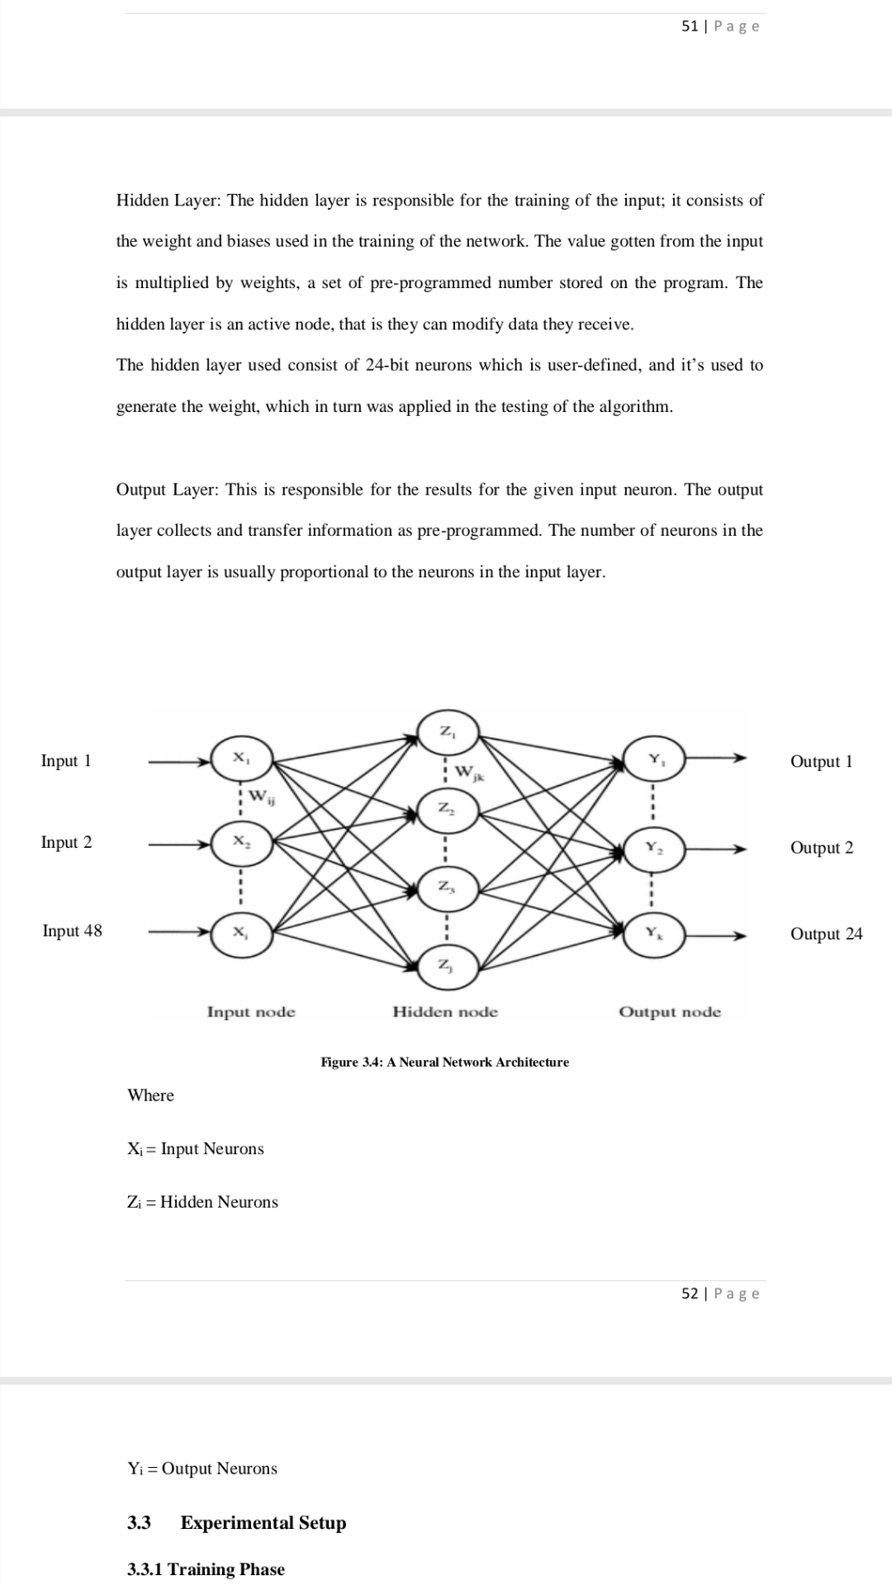
Methodology
Artificial Neural Network Training Architecture
This diagram illustrate the flow of information from the input layer to the output layer through the hidden layer.

Slide 8
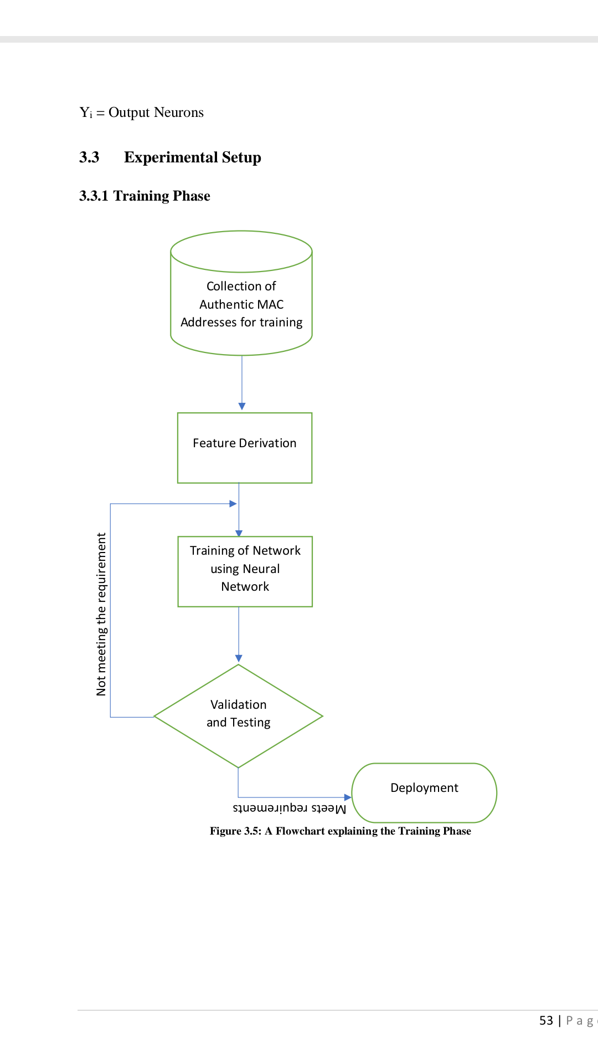
Methodology
This diagram shows the flow chart of how the algorithm is being trained for intrusion detection.

Slide 9
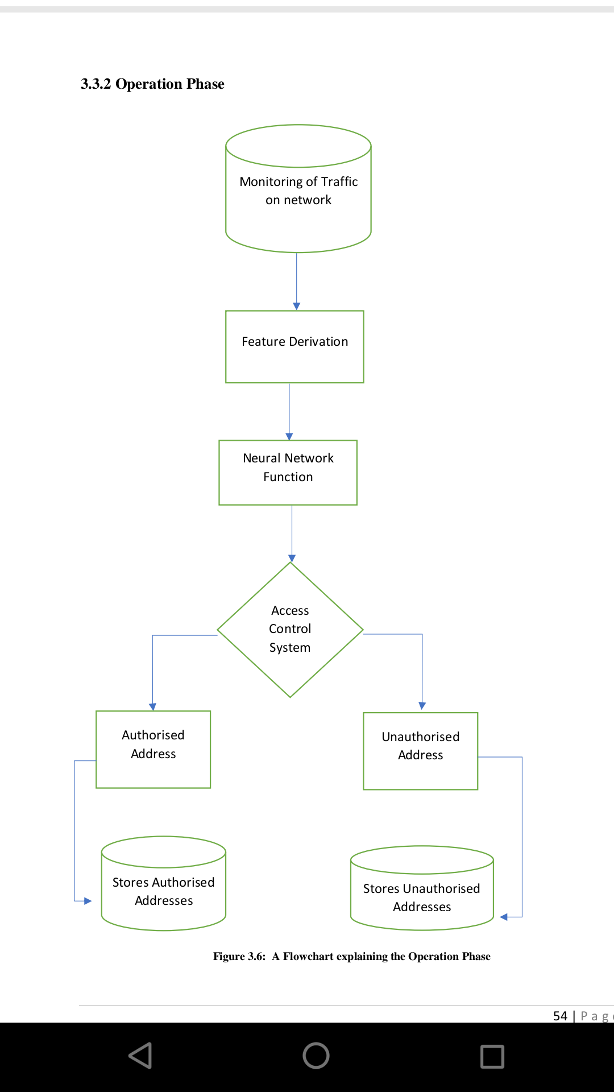
Methodology
This diagram shows the flow chart of how the algorithm trained is used for intrusion detection.

Slide 10
Results
The following graphs depicts the network performance by various training functions.
Mean Square Error (MSE) of 0.2240
Mean Square Error (MSE) of 0.4988

Slide 11
Results
Mean Square Error (MSE) of 0.4996
Mean Square Error (MSE) of 0.4996

Slide 12
Results
Mean Square Error (MSE) of 0.4032
Mean Square Error (MSE) of 0.4993

Slide 13
Results
Determining Optimum Network Architecture

Slide 14
Results

Slide 15
Results

Slide 16
Results

Slide 17
Results

Slide 18
Results

Slide 19
Results

Slide 20
Results

Slide 21
Results
Testing Optimality Of {48-50-24} Network Architecture
ROC Plot of {48-50-24} Network

Slide 22
Results
Performance Evaluation

Slide 23
Results

Slide 24
Conclusion
The project was aimed at designing a network authentication mechanism that can detect and prevent cyber attacks from unauthorized users irrespective of the penetration tool used.

Slide 25


Thank You
Notes:
Image source:-
https://pixabay.com/en/coding-programming-working-macbook-924920/

